Slide 1

Types of Chart
Aksadur Rahman
aksadur@yahoo.com

Slide 2
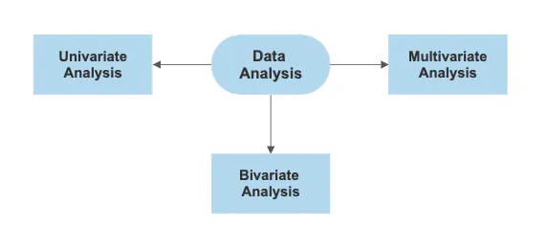

Slide 3
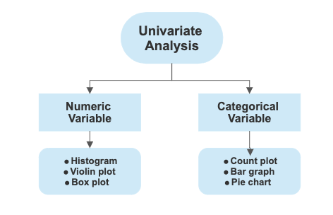

Slide 4
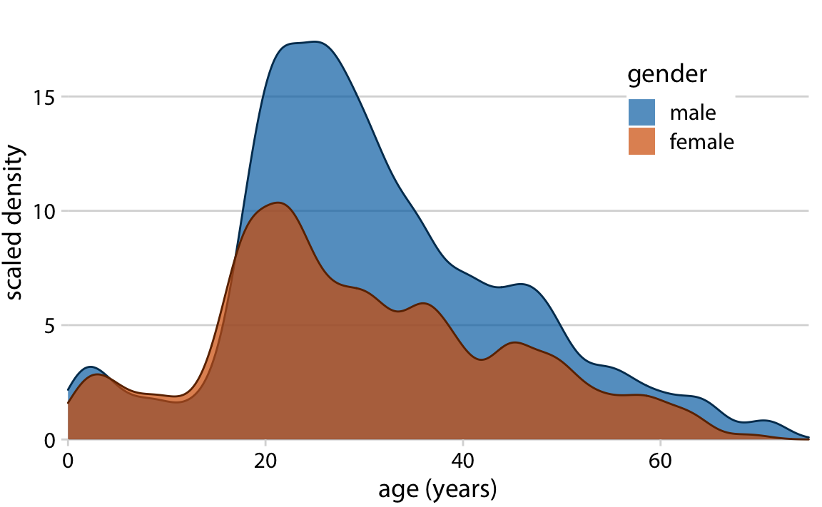
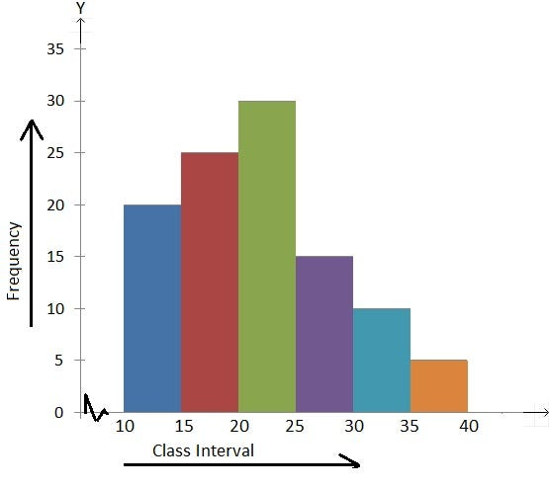
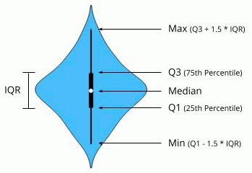
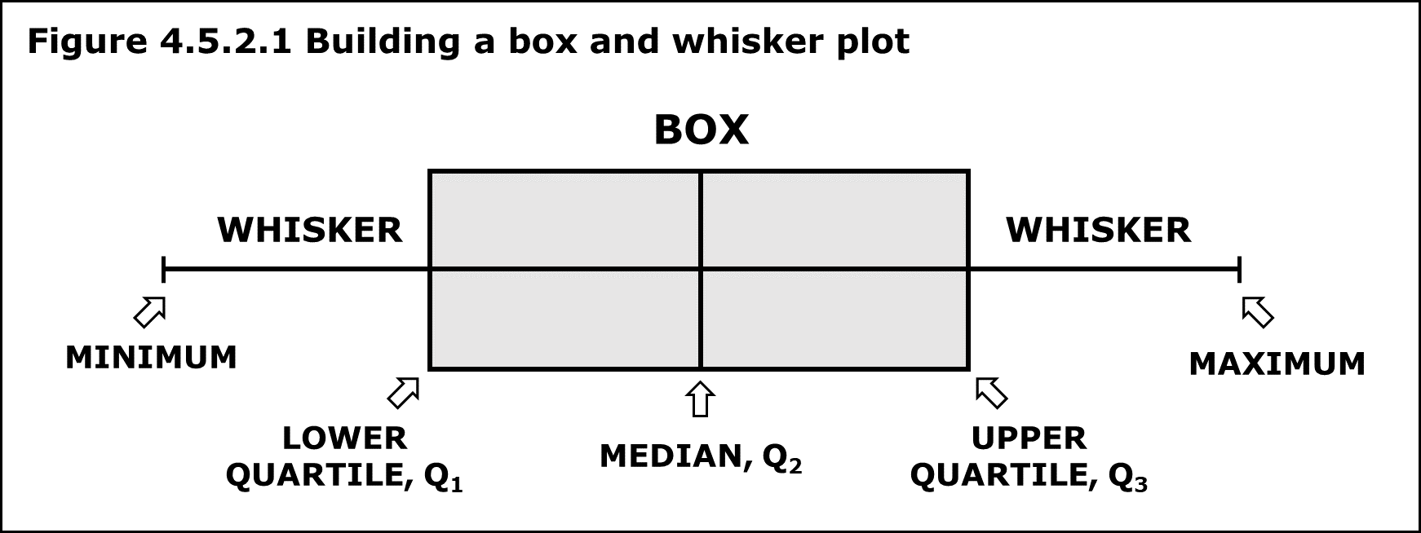
Numeric Variable

Slide 5
Histogram
A histogram is a graph that shows the frequency of numerical data using rectangles. The height of a rectangle is the vertical axis. It represents the distribution frequency of a variable such as the amount or how often that variable appears.

Slide 6
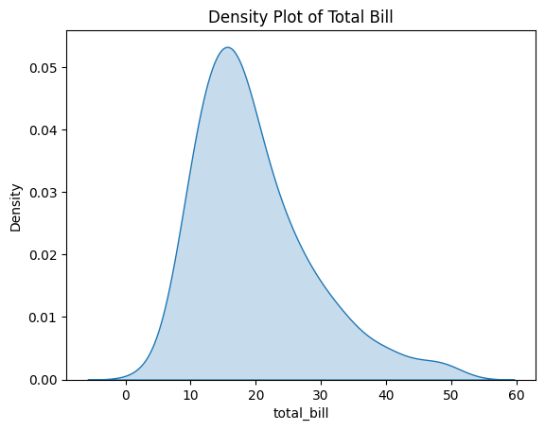
Density Plot

Slide 7
Box Plot
A box plot (aka box and whisker plot) uses boxes and lines to depict the distributions of one or more groups of numeric data.

Slide 8
Violin Plot
A violin plot shows the distribution of data points, including summary statistics and the density of each variable

Slide 9
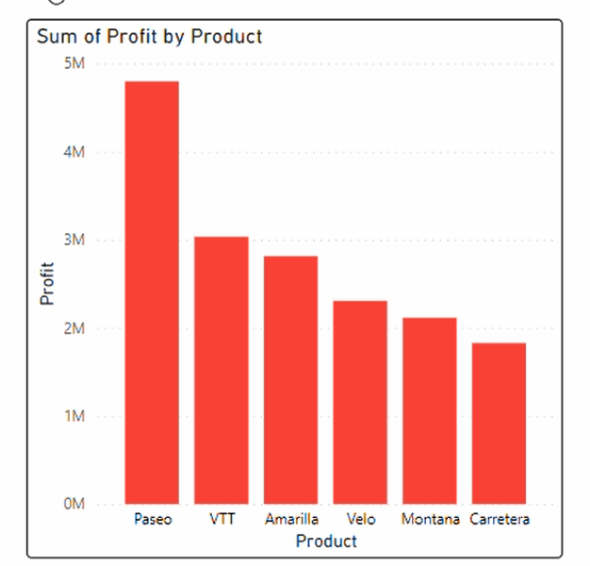
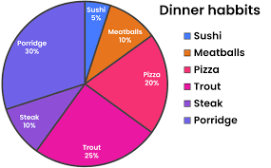
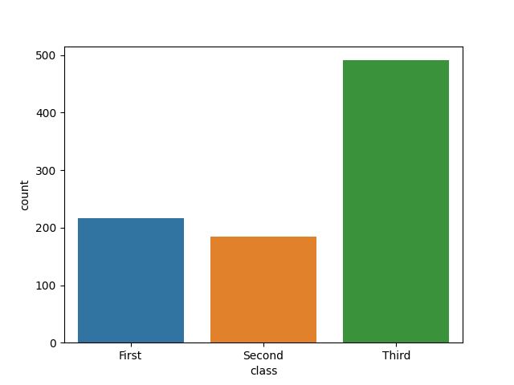
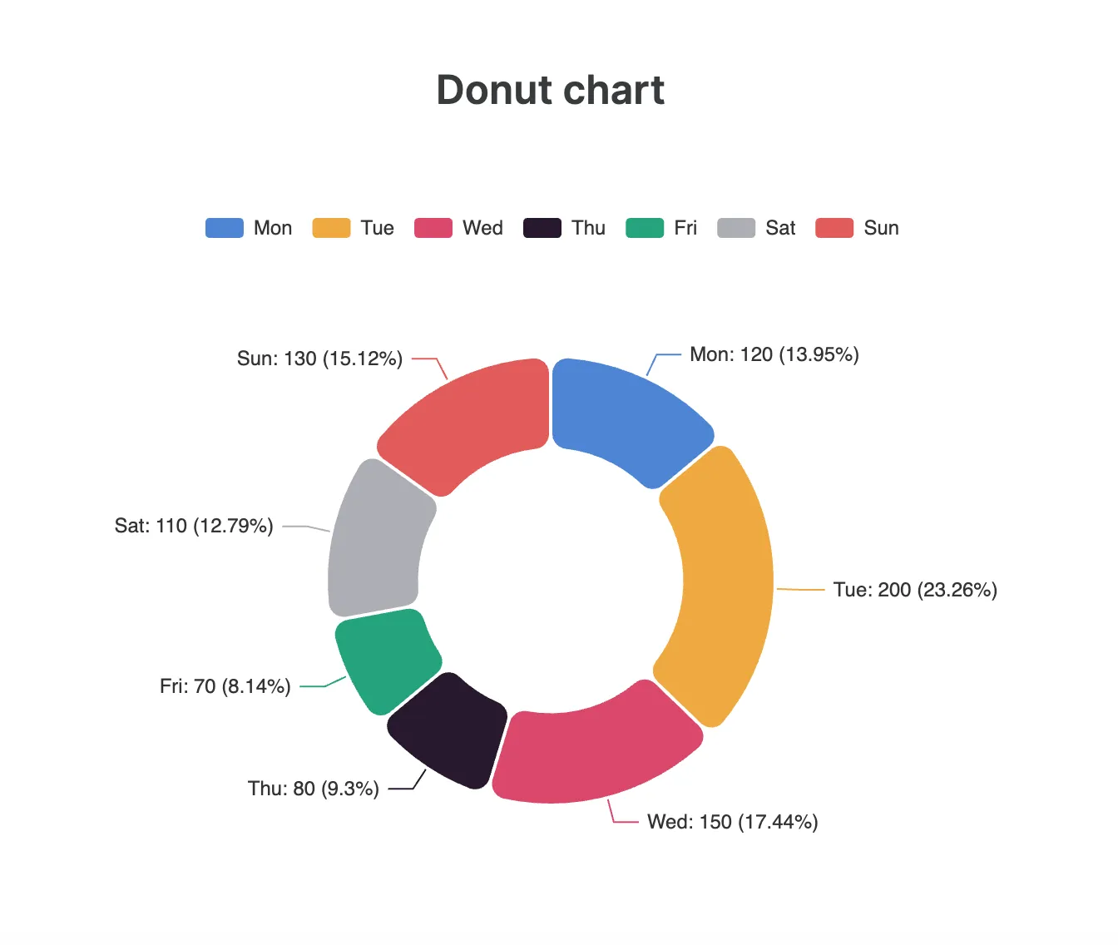
Categorical Variable

Slide 10
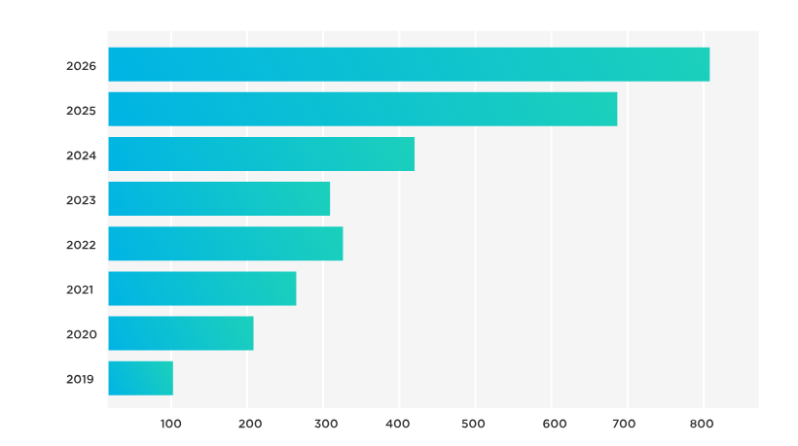
Column Chart
Bar Chart

Slide 11
Pie Chart

Slide 12
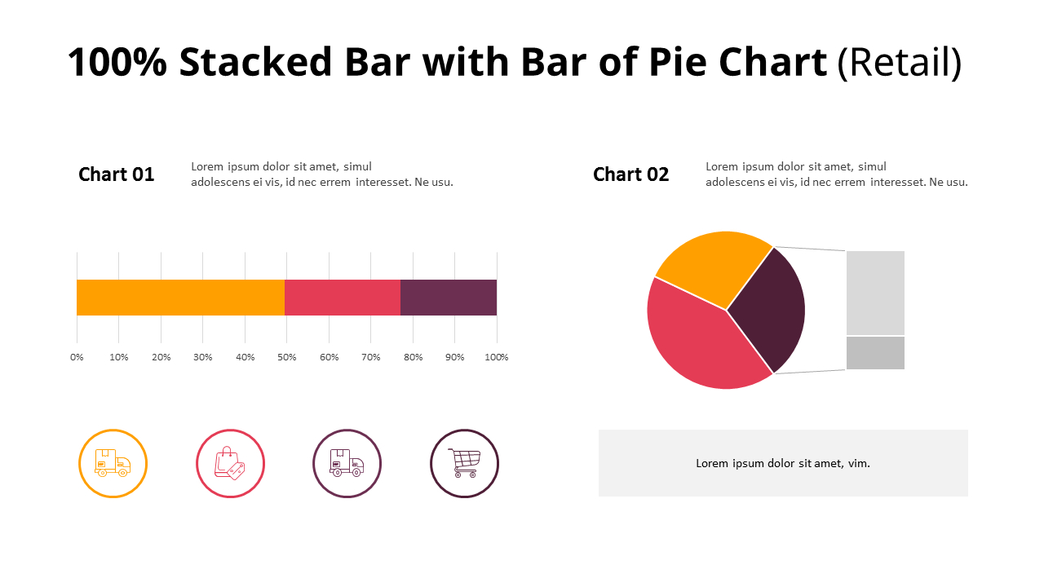
100% stacked bar chart vs Pie Chart

Slide 14
Count Plot

Slide 15
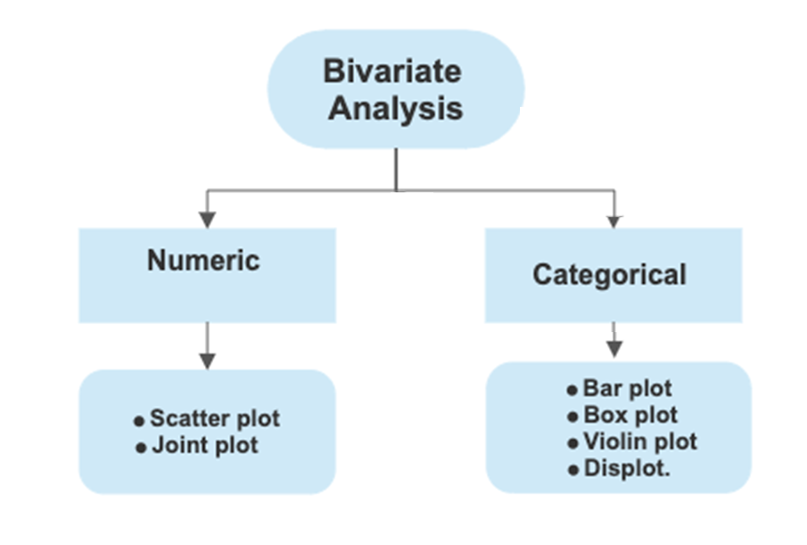

Slide 16
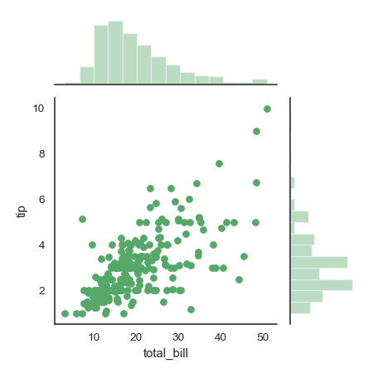
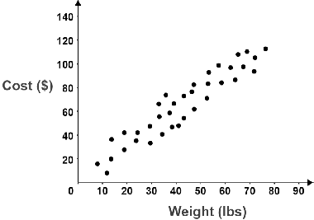
Scatter Plot
Joint Plot

Slide 17
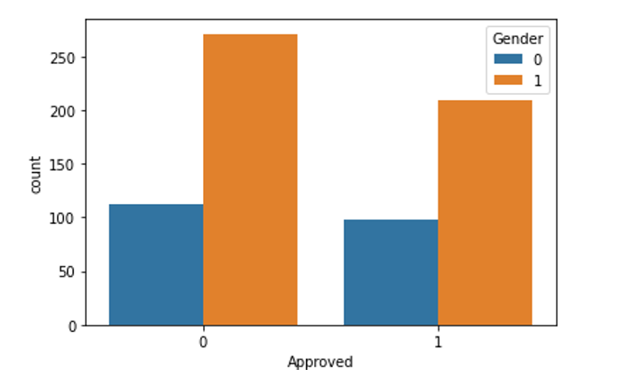
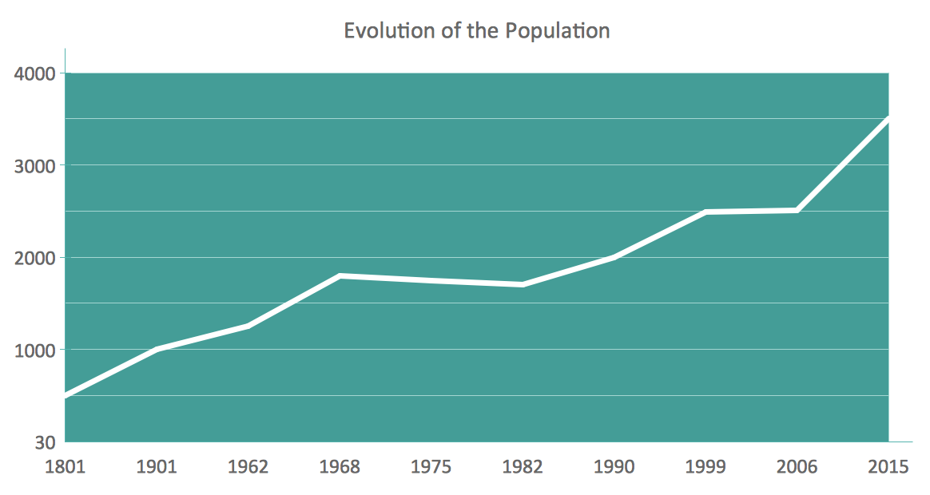
Column Chart
Line Chart

Slide 18
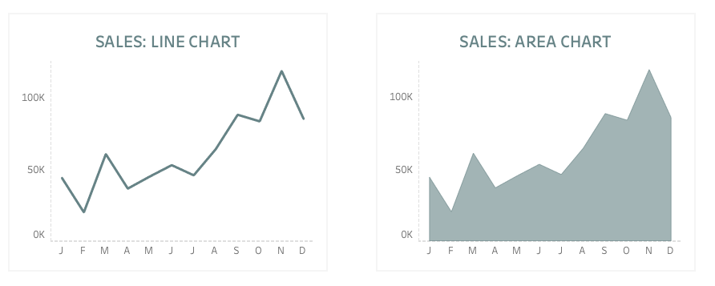
Line Chart vs Area Chart

Slide 19
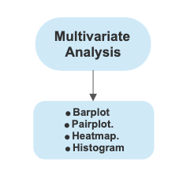

Slide 20
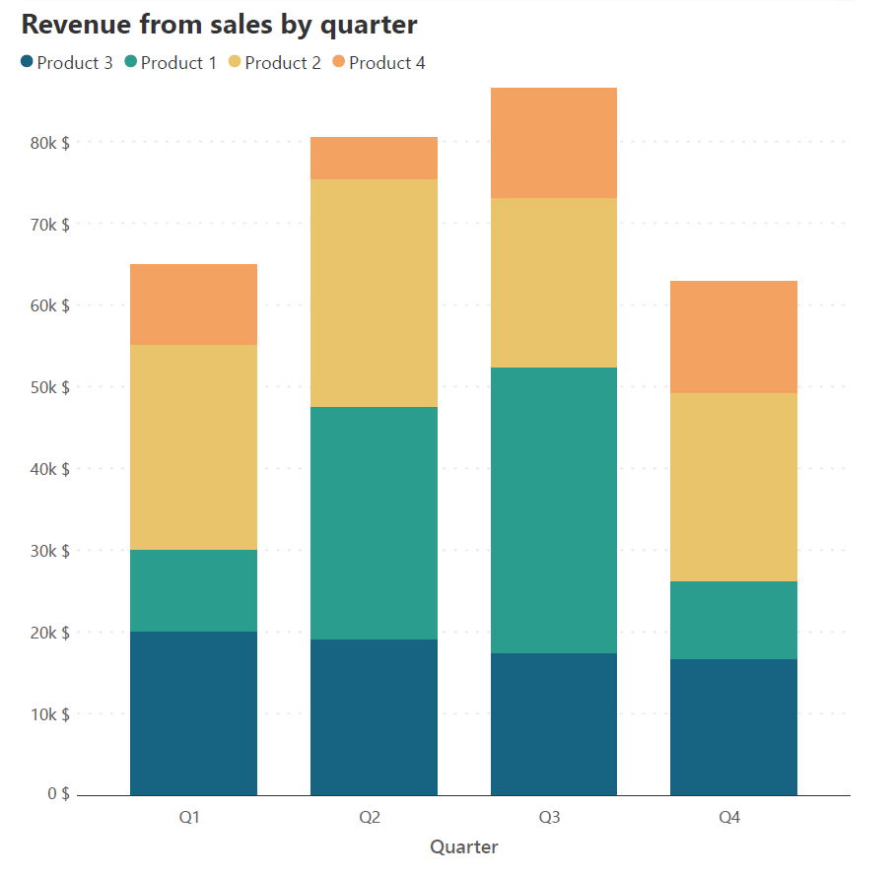
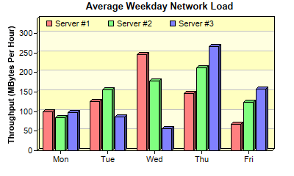
Clustered Column Chart
Stacked Column Chart

Slide 21
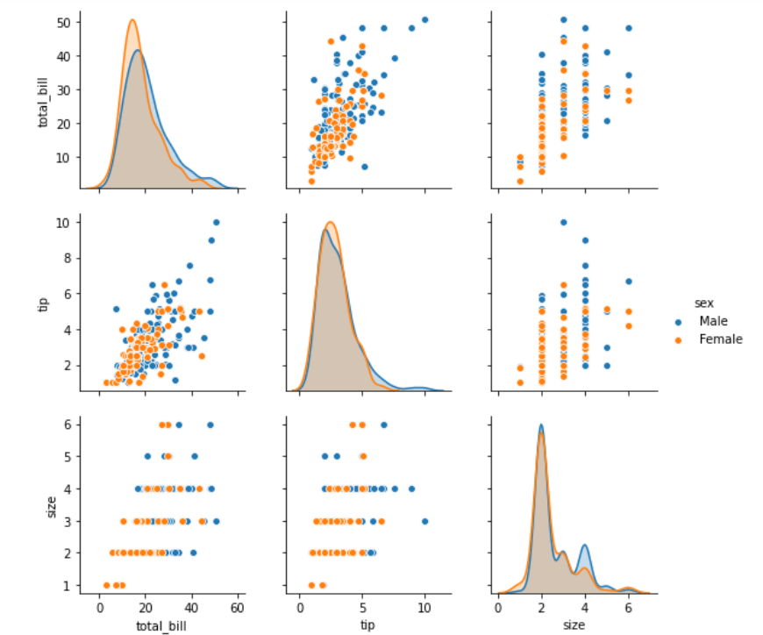
Pair Plot

Slide 22
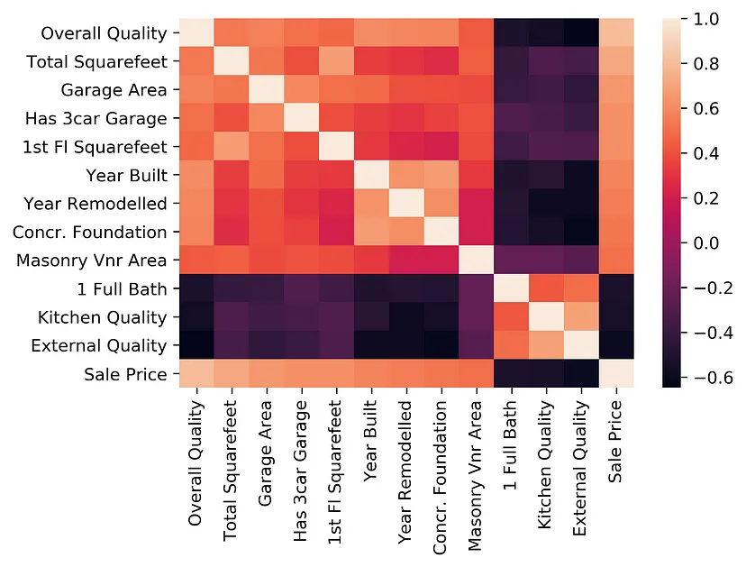
Heat Map

Slide 23
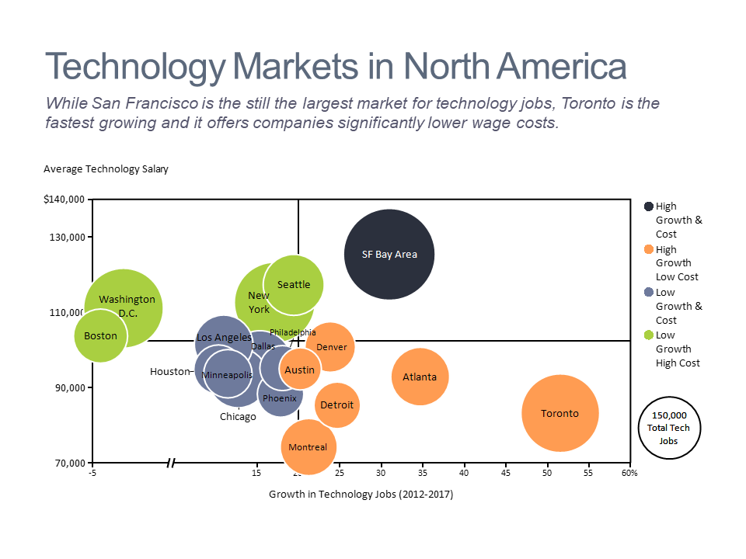
Bubble Chart

Slide 24
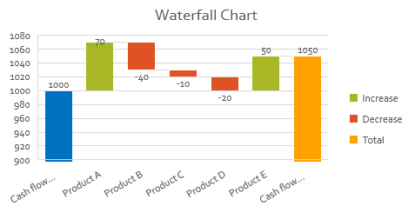
Waterfall Chart

Slide 25
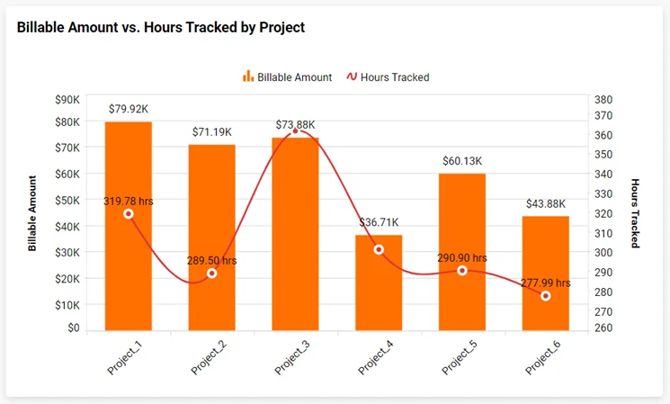
Combo Chart

Slide 26
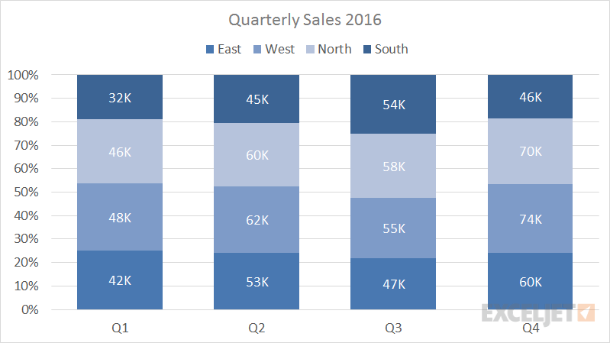
100% Stacked Column Chart

Slide 27

